Slide 1
Loss functions in Deep learning
Neural Network uses optimizing strategies like stochastic gradient descent to minimize the error in the algorithm. The way we actually compute this error is by using a Loss Function. It is used to quantify how good or bad the model is performing. These are divided into two categories (i.e) Regression loss and Classification Loss.

Slide 2
1) Regression Loss Function
Regression Loss is used when we are predicting continuous values like the price of a house or sales of a company.
Types
i) Mean Absolute Error/ L1 loss
ii) Mean Squared Error/Squared loss/ L2 loss
iii) Huber Loss

Slide 3
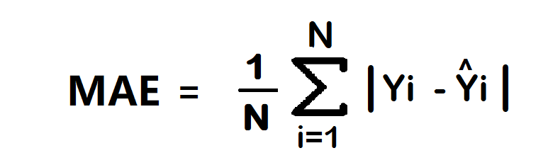
i) Mean Absolute Error/ L1 loss
The Mean Absolute Error (MAE) is also the simplest loss function. To calculate the MAE, you take the difference between the actual value and model prediction and average it across the whole dataset.
Advantage
Intuitive and easy
Error Unit Same as the output column.
Robust to outlier
Disadvantage
Graph, not differential. we can not use gradient descent directly, then we can subgradient calculation.

Slide 4
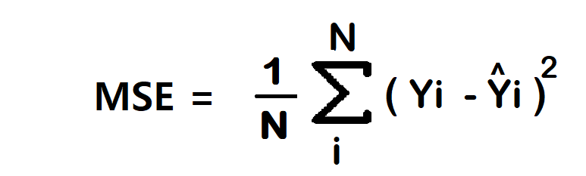
ii) Mean Squared Error/Squared loss/ L2 loss
The Mean Squared Error (MSE) is the simplest and most common loss function. To calculate the MSE, you take the difference between the actual value and model prediction, square it, and average it across the whole dataset.
Advantage
Easy to interpret.
Always differential because of the square.
Only one local minima.
Disadvantage
Error unit in the square. because the unit in the square is not understood properly.
Not robust to outlier

Slide 5
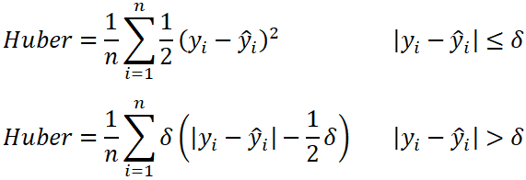
iii) Huber Loss
In statistics, the Huber loss is a loss function used in robust regression, that is less sensitive to outliers in data than the squared error loss.
We can use this loss for classification
n – the number of data points.
y – the actual value of the data point. Also known as true value.
ŷ – the predicted value of the data point. This value is returned by the model.
δ – defines the point where the Huber loss function transitions from a quadratic to linear.

Slide 6
Advantages
Robust to outlier
It lies between MAE and MSE.
Disadvantage
Its main disadvantage is the associated complexity. In order to maximize model accuracy, the hyperparameter δ will also need to be optimized which increases the training requirements

Slide 7
2)Binary Classification Loss Function
Suppose we are dealing with a Yes/No situation like “a person has diabetes or not”, in this kind of scenario Binary Classification Loss Function is used.
i) Binary Cross Entropy/log loss
ii) Hinge loss

Slide 8
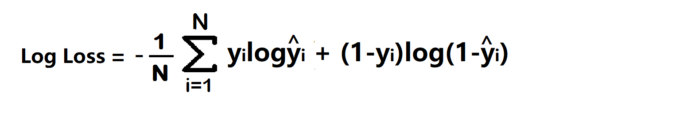
i) Binary Cross Entropy / log loss
It gives the probability value between 0 and 1 for a classification task. Cross-Entropy calculates the average difference between the predicted and actual probabilities.
Advantage
A cost function is a differential.
Disadvantage
Multiple local minima
Not intuitive

Slide 9
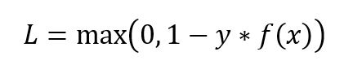
ii) Hinge loss
This type of loss is used when the target variable has 1 or -1 as class labels. It penalizes the model when there is a difference in the sign between the actual and predicted class values.
These are particularly used in SVM models.

Slide 10
3) Multi-Class Classification Loss Function
If we take a dataset like Iris where we need to predict the three-class labels: Setosa, Versicolor and Virginia, in such cases where the target variable has more than two classes Multi-Class Classification Loss function is used.
i) Categorical Cross Entropy Loss
ii) Sparse categorical cross-entropy
iii) Kullback Leibler Divergence Loss

Slide 11
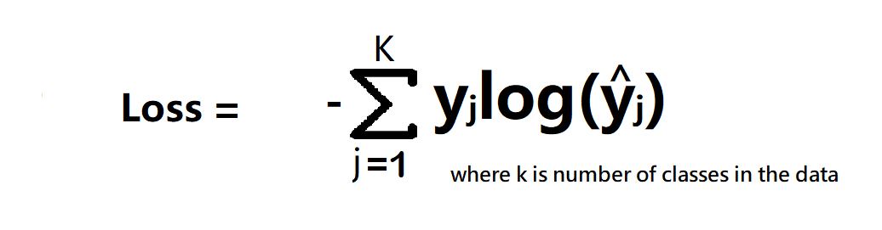
i) Categorical Cross Entropy Loss
Categorical Cross entropy is used for Multiclass classification.
Categorical Cross entropy is also used in softmax regression

Slide 12
ii) sparse categorical cross-entropy
When to use categorical cross-entropy and sparse categorical cross-entropy?
If target column has One hot encode to classes like 0 0 1, 0 1 0, 1 0 0 then use categorical cross-entropy. and if the target column has Numerical encoding to classes like 1,2,3,4….n then use sparse categorical cross-entropy.
Which is Faster?
sparse categorical cross-entropy faster than categorical cross-entropy.

Slide 13
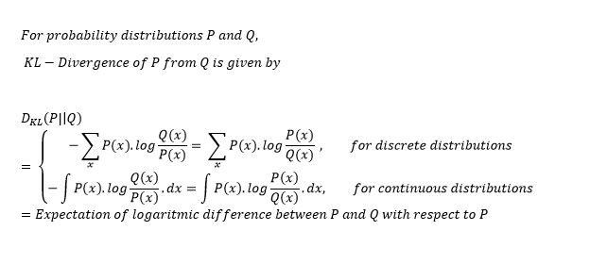
iii)Kullback Leibler Divergence Loss
Kullback Leibler Divergence Loss calculates how much a given distribution is away from the true distribution. These are used to carry out complex operations like autoencoder where there is a need to learn the dense feature representation.
KL-Divergence is used more commonly to approximate complex functions than in multi-class classification. We come across KL-Divergence frequently while playing with deep-generative models like Variational Autoencoders (VAEs).

